Slide 1


Day – 6 : Data types and Constrains in SQL
Course created by Satish Dhawale | www.skillcourse.in

Slide 2
Numeric Data Types
Data Type | Description | Example Use
INTEGER | Stores whole numbers. | Employee IDs, Age
SERIAL | Auto-incrementing integer. | Primary key auto-increment
BIGINT | Stores large integers. | Population, Large counts
NUMERIC(p, s) | Stores exact numbers with precision (p) and scale (s). | Financial data (salary)
REAL | Stores floating-point numbers (single precision). | Scientific calculations
DOUBLE PRECISION | Stores double-precision floating-point numbers. | High-precision computations

Slide 3
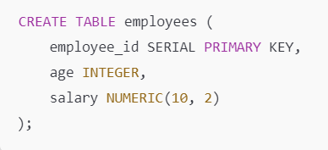
Example

Slide 4
Character Data Types
Data Type | Description | Example Use
CHAR(n) | Fixed-length string of n characters. | Employee codes
VARCHAR(n) | Variable-length string up to n characters. | Names, Email addresses
TEXT | Unlimited-length string. | Descriptions, Comments

Slide 5
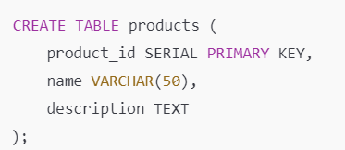
Example

Slide 6
Date and Time Data Types
Data Type | Description | Example Use
DATE | Stores date (year, month, day). | Birthdate, Hire date
TIME | Stores time (hour, minute, second). | Appointment times
TIMESTAMP | Stores date and time. | Order timestamps
TIMESTAMPTZ | Stores date and time with timezone info. | Global event tracking
INTERVAL | Stores duration of time. | Duration between events

Slide 7
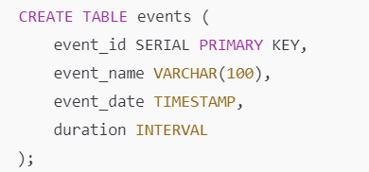
Example

Slide 8
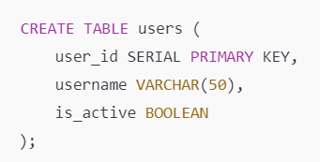
Boolean Data Type
Data Type | Description | Example Use
BOOLEAN | Stores TRUE, FALSE, or NULL. | Flags, Active status

Slide 9
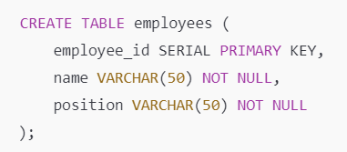
PostgreSQL Constraints:
In PostgreSQL, constraints are rules enforced on data in tables to ensure accuracy, consistency, and integrity. They define conditions that the data must meet and are applied to columns or tables during table creation or modification.
NOT NULL Constraint
UNIQUE Constraint
PRIMARY KEY Constraint
FOREIGN KEY Constraint
CHECK Constraint
DEFAULT Constraint
EXCLUSION Constraint

Slide 10
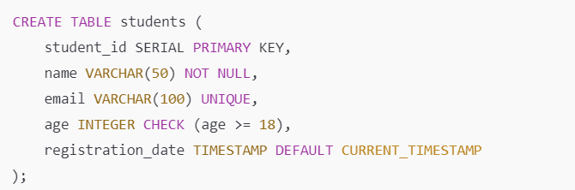
Assigning Constraints
PRIMARY KEY: student_id uniquely identifies each student.
NOT NULL: name cannot be NULL
UNIQUE: email must be unique.
CHECK: age must be 18 or older.
DEFAULT: registration_date defaults to the current time.

Slide 11
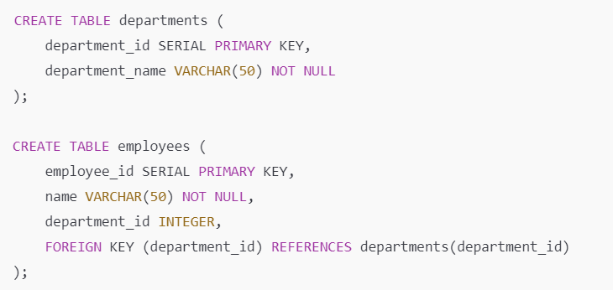
FOREIGN KEY Constraint
The FOREIGN KEY constraint ensures that values in a column match values in another table’s primary key, maintaining referential integrity.

